Slide 1




VocAL Voice Biomarker for AD Progression Assessment MIT Sandbox| Dhive_ 2023 Summer

Slide 2
Index
Team
Alzheimer's Disease (AD) diagnosis process
Proposed solution
Customer segmentation hypothesis
Key learnings from top 3 interviews
Problem and unmet need
Key customer segment identification
Personal lessons

Slide 3




Team
Yujie Wang
Arcita Pramudita
Carter Frame
Kailin Xu
Customer segment | Description | Amount
Family caregiver | Family members having experience taking care of their AD loved ones | 2
Doctor/ Provider | Psychiatrist or neurology with clinical experience seeing AD patients | 5
Pharma | Interviewees with experience developing tools for AD or working in, with, or sell to pharmaceutical company | 3
Other | JD, data security, Agetech researcher | 2
Total |  | 12

Slide 4
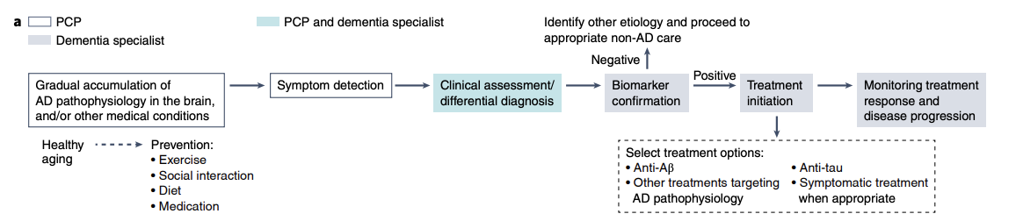
Current process of screening, diagnosis, and progression monitoring
Brain imaging
CT
MRI
Amyloid, Tau PET
Cerebrospinal fluid biomarkers (CSF)
Biomarker
Blood Test
Genetic Profiling
Cognitive test
MMSE
Clock Test
ADAS-Cog
MoCA
CAMCOG
Note: MMSE: Mini-Mental State Examination, ADAS-Cog: Alzheimer’s Disease Assessment Scale-cognitive subscale, PCP : Primary Care Physicians
Notes:
https://www.nia.nih.gov/health/how-biomarkers-help-diagnose-dementia
https://www.camh.ca/en/professionals/treating-conditions-and-disorders/dementia/dementia---screening-and-assessment
Other tests and sclaes: https://www.ncbi.nlm.nih.gov/pmc/articles/PMC3487532/
In-clinic and in-person setting
Visiting primary care doctor is often the first step
Neurologists — doctors who specialize a in disorders of the brain and nervous system — are often consulted to diagnose dementia
Hampel, H., Au, R., Mattke, S. et al. Designing the next-generation clinical care pathway for Alzheimer’s disease. Nat Aging 2, 692–703 (2022). https://doi.org/10.1038/s43587-022-00269-x​

Slide 5
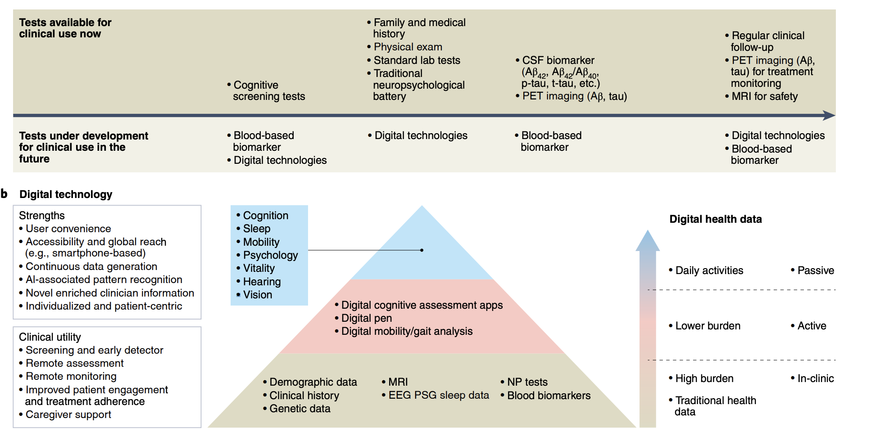
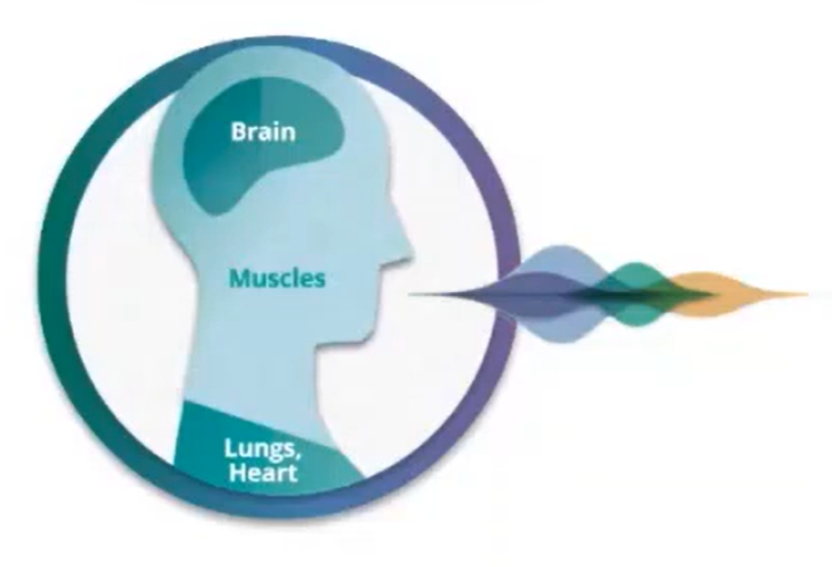
Proposed Solution
Voice as biomarker for AD progression
Voice brings an unique layer of understanding to cognitive assessments by accounting for content (what is said) & acoustic properties (how it is said)
Mechanism: Changes in brain & nervous system --> dramatic effects on speech & language --> voice biomarkers --> monitoring neurological & psychiatric disorders
Voice offers richer objective understanding of patient functioning at both an individual and group level
Notes:
Hampel, H., Au, R., Mattke, S. et al. Designing the next-generation clinical care pathway for Alzheimer’s disease. Nat Aging 2, 692–703 (2022). https://doi.org/10.1038/s43587-022-00269-x
Comparison:
In clinic vs home based
Point assessment vs longitudinal option
Subjective and Objective
Limited distribution vs Scaled distribution

Slide 6
Customer Segmentation Discovery and hypothesis
1
Customer Segments
2
Hypothesized Value Proposition
Pharma in AD treatment R&D space and Clinical trial recruiting vendors | Scaling the screening of eligible patient population for clinical trials from 20k to 500K+, and lowering the cost of screening by 80% Higher engagement rate and better patient adherence by ~30% Affordable longitudinal assessment Enable decentralized data collection and impove data analysis
Patients & Care giver | Users' convenience Independent with care giver assistance Reduce Caregiver burden Lower the barrier and costs for patient to come into clinic for study follow up
Doctors and providers | More frequent and objective disease progression monitoring Detection of comorbidities
Payers and insurance company | Enable more cost-effective diagnostic tool for treatment prior authorization Prevention driven solution

Slide 7

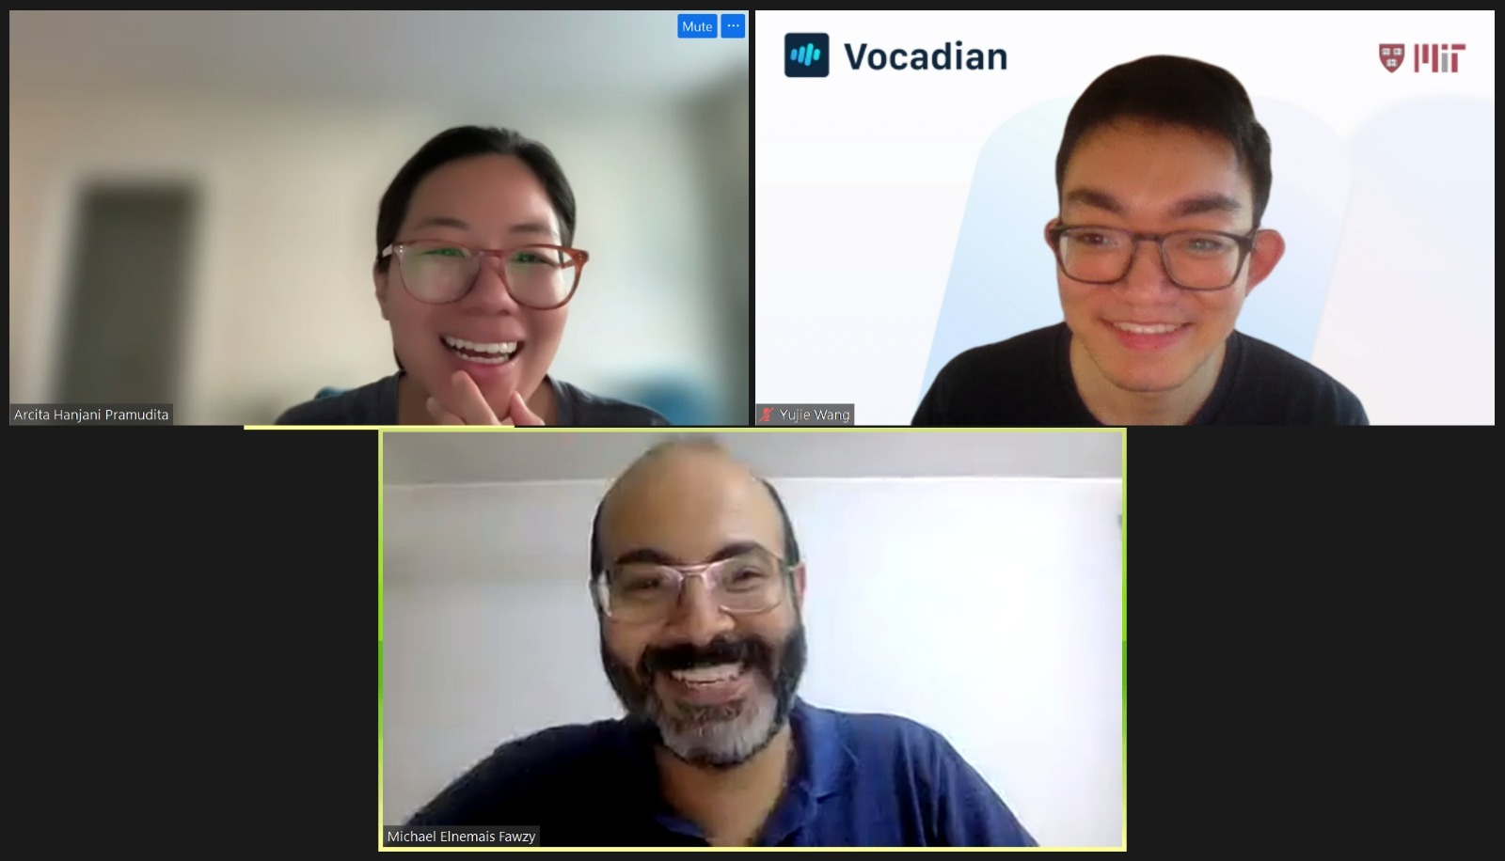



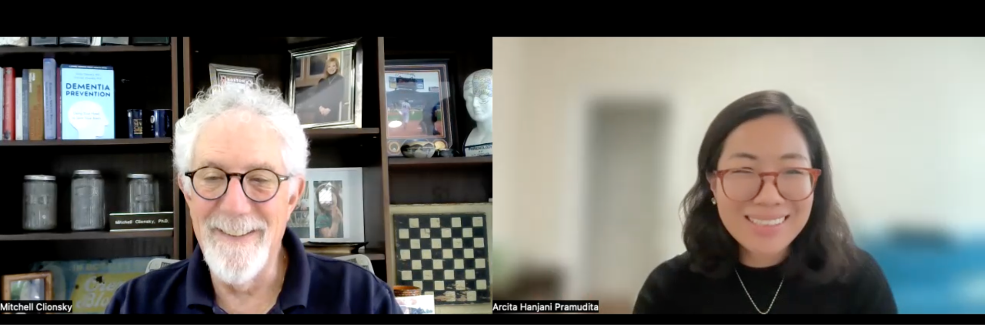
Our interviews

Slide 8

Key Learnings from top 3 Interviews
Key learnings
“Need a sensitive tool to decide new intervention to patients”
Many have accompanying symptoms like physiological or hallucination, or depression​
Neuro psychological & cognitive assessment not always available ​
MMSE/ MoCA are the most used cognitive score but not enough in telling the new symptom​
Many standard endpoints measurement tool are not available in the clinic
Walaa Elsayed​
Associate professor of neurology in Egypt, research scholar at Northwestern University​
Notes:
, finding the ground truth can be a challenge

Slide 9

Key Learnings from top 3 Interviews
Key learnings
“Pharma can be the primary buyer”
Voice is great potential in scaling the initial screening of eligible patient in clinical trials
The pathology of AD is controversial, and endpoints are fuzzy
Biomarker using MRI and PET very expensive
A route is to become the standard and seek FDA approval but need expensive clinical trial
Katelyn Connelly
Researcher with experiences in clinical trial
Notes:
, finding the ground truth can be a challenge

Slide 10

Key Learnings from top 3 Interviews
Key learnings
“Pharma can be the primary buyer”
Voice as biomarker has great potential in scaling the initial screening of eligible patient for clinical trial
The pathogen of AD is controversial and endpoint is fuzzy, finding the ground truth is challenging
A route is to become the standard thru FDA approval
William Souillard-Mandar
Mentor AI & Neuroscience | Investor | MIT
Notes:
, finding the ground truth can be a challenge

Slide 11




Problem and Unmet Need
Screening and identify eligible patients
Mid-trial de-risk
Limited tool for massive screening
Costly and time-consuming patient selection and recruitment
Periodic in-person assessment
Patient adherence
Need of more accessible assessment tool
RCT midpoint evaluation
Provide preview of the efficacy before performing standard tests
Clinical trial design
Patient Recruitment
Follow up & data collection
Data analysis
Stage assessment
Lack of tool for stage assessment
Stage needed for FDA approval
Stage progression rate and order vary by patients

Slide 12
Our primary customer: Pharmaceutical companies in AD R&D with the value of scaling & accelerating eligible patient screening
Customer Discovery
1
Customer Segments
2
Primary Value Proposition
3
Secondary Value Proposition
Pharma in AD treatment R&D space and Clinical trial recruiting vendors | Scaling the screening of eligible patient population for clinical trials from 20k to 500K+ lower the cost of screening by 80% Higher engagement rate and better patient adherence by ~30% | Data analysis Affordable longitudinal assessment Enable decentralized data collection
Our main customer segmentation

Slide 13
Personal lessons
Lessons
Lack of training on how to communicate
life-changing
full-time commitment
Behavioral disorder: symptoms are unpredictable
Unmeet emotional need
Caregiver burnout
Next step
Primary research
Secondary research
Business model
Reimbursement
Clinical Trial for the technology
Address potential ethical issues
Validating the technology with gold standard screening for Alzheimer
Notes:
Clinical trials can act as an opportunity to further validate technology for other customer segments .

Slide 14
Thank you

